Slide 1

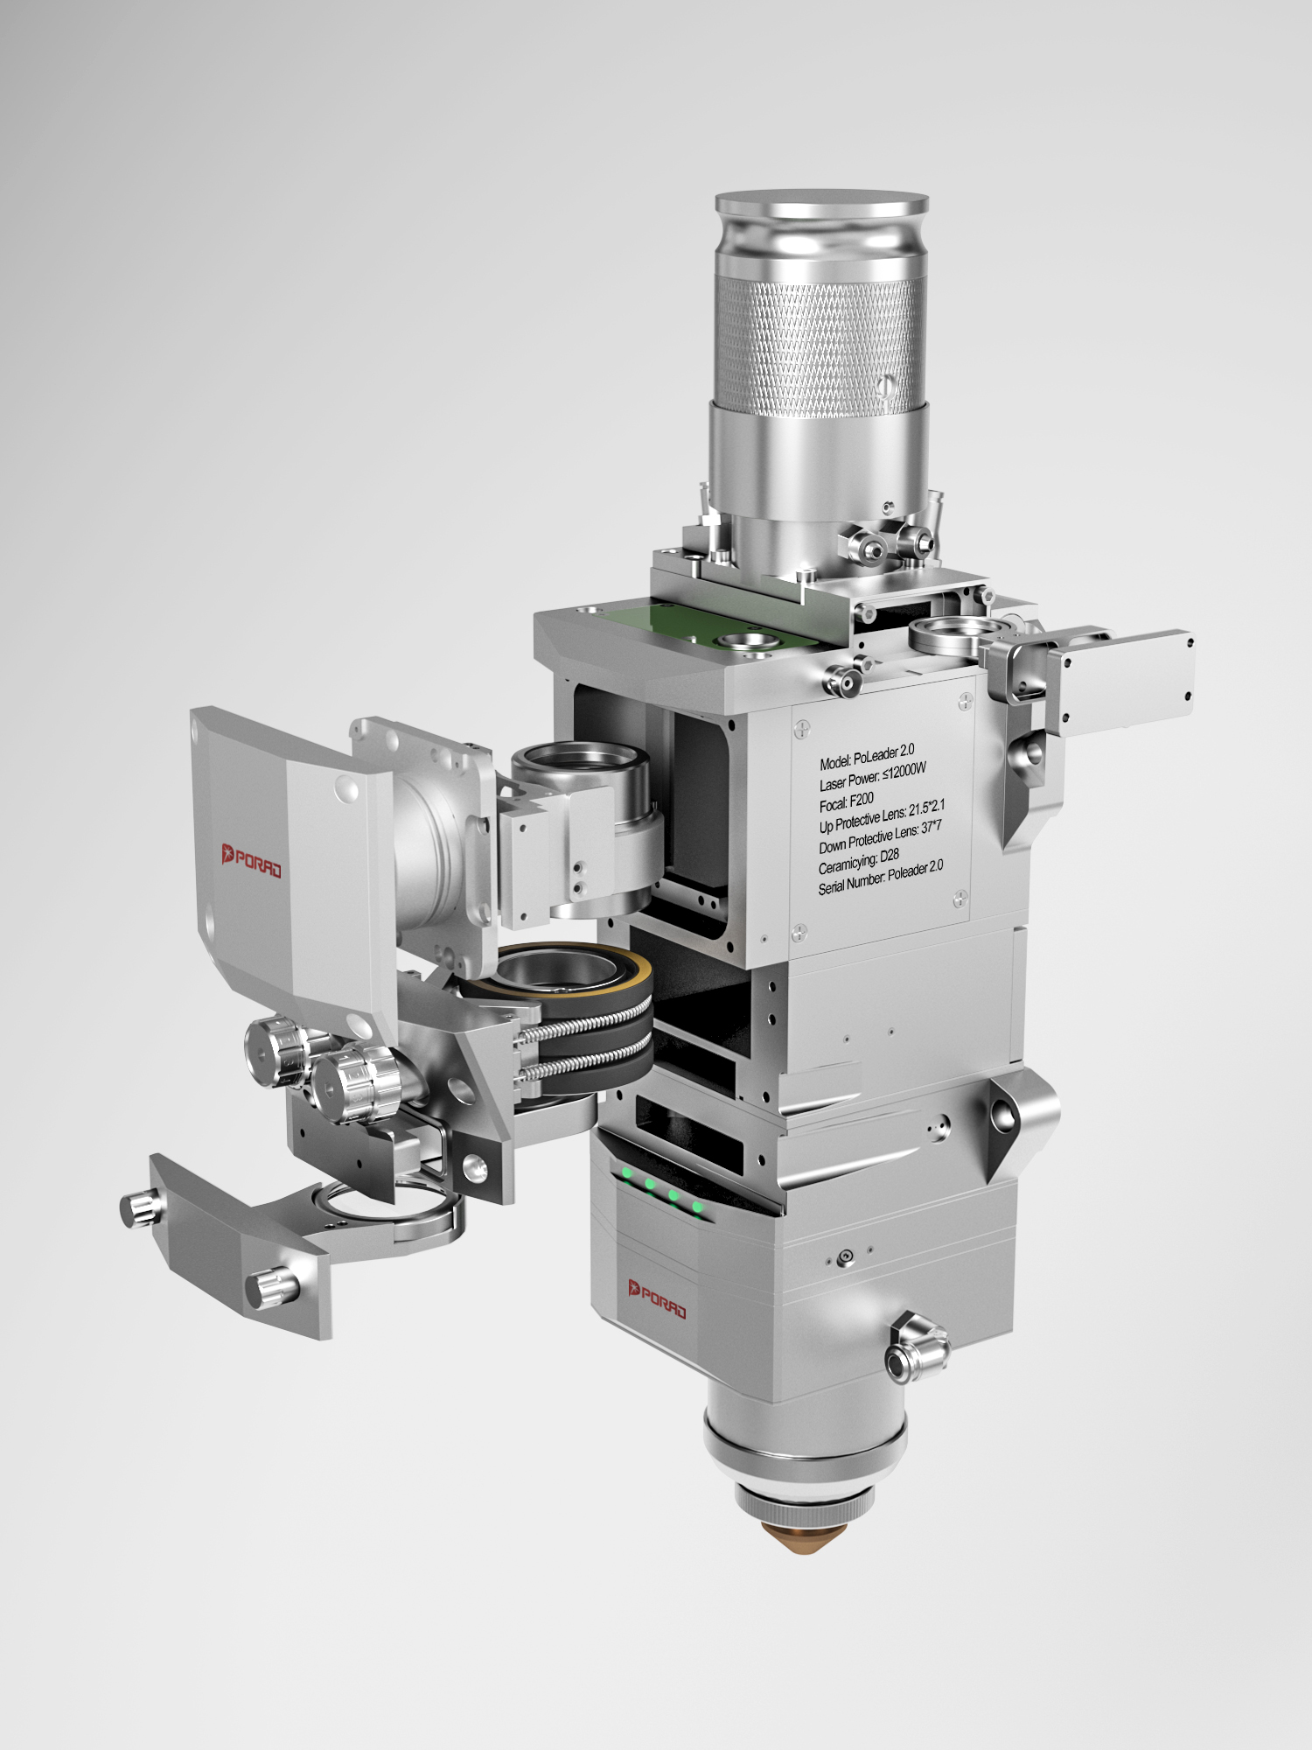
PoLeader2.0S Operating Instructions for the Ultra High Power Series Products
Suzhou Polonium Radium Automation Technology Co., Ltd
Suzhou Polonium Radium Automation Technology Co., Ltd
Suzhou Porad Automation Technology Co.,Ltd
Tel: 0512-36694173
Fax: 0512-50173236
Address: Room 418, Yuda Science Park, No.6, Leshan Road, Leshan Town, Kunshan City, Jiangsu Province
Email: www.szporad.com
Website: www.szporad.com

Slide 2

PoLeader2.0S Ultra High Power Cutting Head Series Operating Instructions
Version | V1.0
Date | 2020.5.23
Author | Su group
Approver
First of all for using our products!
This manual details the use methods and precautions of PoLeader2.0S ultra-high power series laser cutting head, including installation, operation, maintenance, etc. If you still want to learn more information, please contact us directly.
Due to the rapid product function upgrade, the actual product you have received is somewhere different from the description of this manual. We apologize here. Please consult us if you have any questions.

Slide 3
PoLeader2.0S Ultra High High Power Cutting Head Series Operating Instructions
Directory
An overview of.................................................................2
1.1 Technical parameters..........................................................2
1.2 Product advantage..........................................................2
1.3 Overall structure of the laser head...............................................3
Two cutting head is basically configured with................................................4
2.1 Standard Shipping List List............................................4
2.2 Cutting head dimension.......................................................4
2.2.1 Q + optical fiber optic interface cutting head dimension...............................4
2.2.2 QBH optical fiber optic interface cutting head dimension............................5
Three to Install................................................................5
3.1 Mechanical installation hole position................................................5
3.2 Water route and gas road connection:.............................................6
3.2.1 Waterway installation of....................................................6
3.2.2 Air road installation....................................................8
Four-system installed commissioning...................................................9
4.1 Cable connection and interface definition.....................................9
4.2 Connect of the focus control board card to the upper machine........................9
4.3 Setting............................................11
4.3.16 Focus formula..................... 11 for F200 of ~ 10 KW
4.3.2 Focus formula................... 12 for F200 of 10 ~ 30 KW
4.3.3 Focus formula......................................12 for F150
4.4 Status alarm information of the LED lamp.................................13
4.5 Focus position calibration...............................................15
4.6........................................16
Five Product Operating Instructions............................................17
5.1 Beam tuning (QBH Interface)................................................. 17
5.2 Adjust the focus position of....................................................18
VI Maintenance...........................................................19
6.1 Lens Cleaning........................................................19
6.1.1 Lower protection mirror to replace.............................................19
6.1.2 Focus protection Replacement.............................................20
6.2 Replace the nozzle and the ceramic body...........................................21
Conclusion.........................................................................23

Slide 4
PoLeader2.0S Ultra High Power Cutting Head Series Operating Instructions
I: Overview
The PoLeader2.0S is an ultra high power smart focus, fiber cutting head introduced by PORAD in 2020.With QBH,Q + and QD, the PoLeader2.0S with the highest power of 30KW will bring a higher quality and faster cutting experience to the laser processing industry. The new design of cooling mode can bring more efficient cooling effect to the optical lens, to ensure the stability of batch cutting; the new design of focus protection replacement mode, to solve the trouble of field replacement focus protection and the risk of ash fall.
1.1: Technical parameters
Applicable optical fiber power: ≤ 30KW
Focus mirror focal distance: 200mm
Focus adjustment range: + 15mm ~ -30mm
Control mode: analog quantity control
Upper protection mirror specification: ø21.5mm*2mm
Lower protection mirror specification: ø37mm*7mm
Auxiliary gas air pressure: ≤ 2.5MPa
Weight: 6.5~7.0KG
1.2. Product Advantages:
●'s new focus protection replacement method provides great convenience for the replacement of the focus protection lens and effectively reduces the risk of ash fall.
● Fast Cool cooling technology can effectively cool the cutting nozzle and cut the sheet surface, solving the problem of poor cutting quality due to high temperature.
●'s new body water cooling way, more efficient cooling optical lenses; ensure the stability of plate cutting.

Slide 5
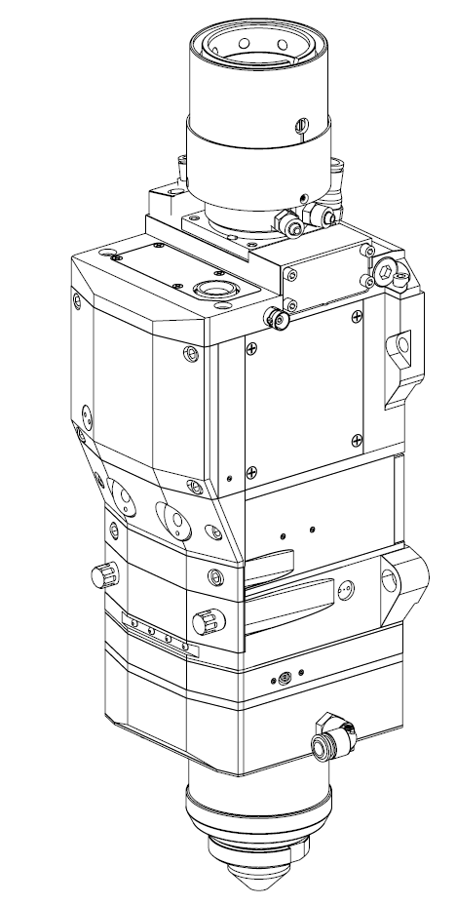
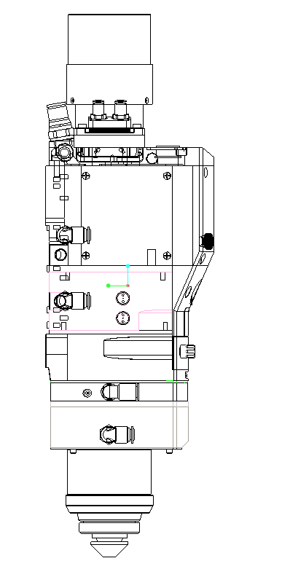
PoLeader2.0S Ultra High Power Cutting Head Series Operating Instructions
The ● can read the monitoring data from the mobile terminal via a wireless network.
● designed a new and effective cutting air road, solved the problem of cutting direction due to the influence of air road during plate cutting, and ensured the consistency of all direction effects of the finished product.
1.3: Overall structure of the laser head
1
16
8
14
2
9
15
3
10
17
4
5
6
19
7
18
11
12
13
Figure 1.1 Overall structure of the PoLeader2.0S laser head
1: Fiber optic interface (Q +) 9: Upper protection mirror module
2:19pin control cable interface 10: BNC interface (elevation length cable interface)
3: Collimation module F_{C} 11,15,17,18: Cutting head water interface Φ 6
4: Focus module Ff 12: locking nut
5: Focus protection mirror drawer 13: spray nozzle
6: Lower protection mirror drawer 14: Cut the air interface
7: LED status indicator lamp 16: waterway interface Φ 8
8: Water interface Φ 6(optical fiber interface) 19: Cooling gas interface Φ 8

Slide 6
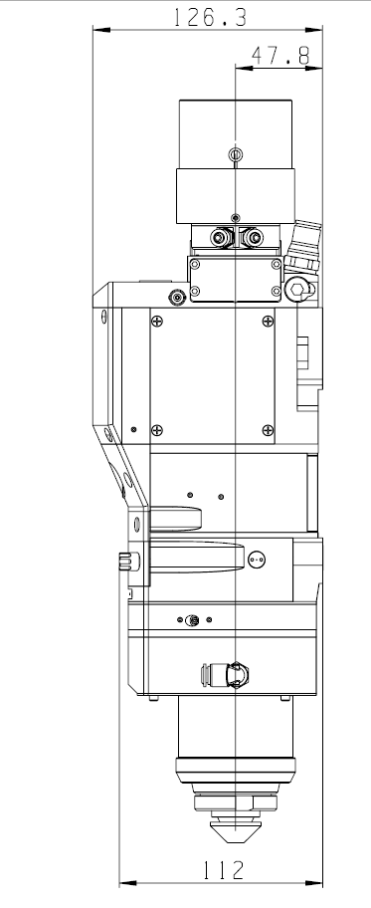
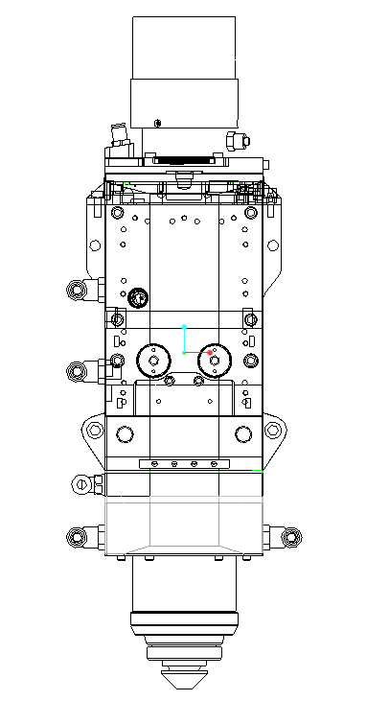
PoLeader2.0S Ultra High Power Cutting Head Series Operating Instructions
II: Basic configuration of the cutting head:
2.1: Standard Delivery List List:
2.2: Cutting head size
2.2.1: Size of Q + optical fiber optic interface cutting head
PoLeader2.0S Series Backing List
No ial | Product | Unit No | Quantity
1 | PoLeader2.0S cutting head | Desk | 1
2 | Focus control card | Ten | 1
3 | 16. m control line | Article | 1
4088
112
108
Figure 2.1 Cutting head size of the PoLeader2.0S Q + optical fiber interface

Slide 7
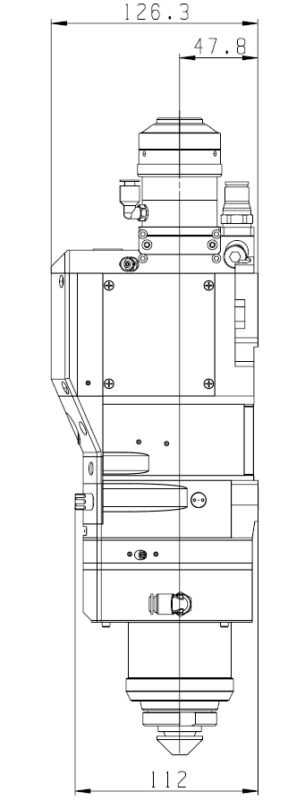
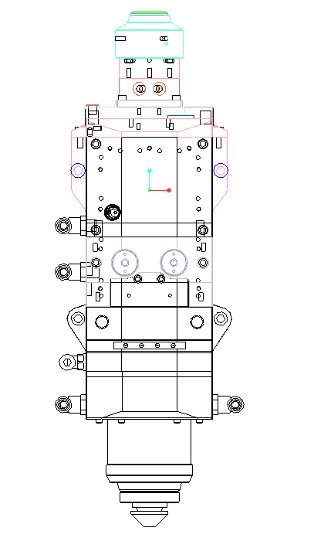
PoLeader2.0S Ultra High Power Cutting Head Series Operating Instructions
2.2.2: QBH fiber optic interface cutting head dimensions
III: Installation
3.1: Mechanical installation hole position
The size and position relationship of PoLeader2.0S series laser machining head and fixed machine tool is shown in Figure 3.1. It is recommended that the customer install the laser head perpendicular to the machining plate surface as required, and ensure that the laser head is locked, which is one of the preconditions for ensuring the subsequent stable cutting effect.
112
389
108
Figure 2.2 Cutting head size of the PoLeader2.0S QBH optical fiber interface

Slide 8
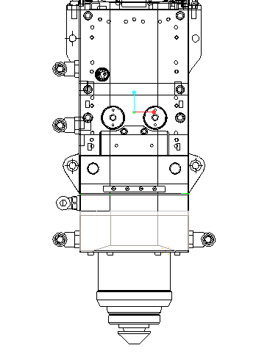
PoLeader2.0S Ultra High Power Cutting Head Series Operating Instructions
3.2: Water route and gas road connection
3.2.1: Waterway installation
The PoLeader2.0S series laser processing head has a total of 4 sets of cooling water waterways, and the direction of its water entry and exit can be arranged arbitrarily. The location and quantity of water-cooled interfaces can be shown in Figure 3.2 below.
Detailed parameters of waterway connection are shown in Table 3.1.
112
108
Figure 3.1 Schematic diagram of the PoLeader2.0S series backplane mounting hole position

Slide 9
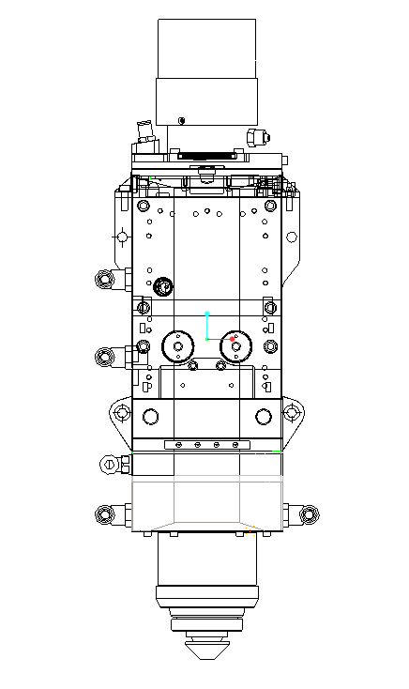
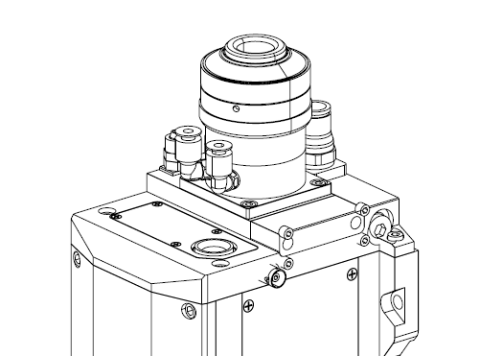
PoLeader2.0S Ultra High Power Cutting Head Series Operating Instructions
1
2
5
6
3
4
Figure 3.2 Schematic diagram of PoLeader2.0S series waterway installation
1: Water interface, Φ 8(cooling collimation area), external diameter of water pipe is 8mm, internal diameter is 6mm.
2: Water interface, Φ 6 (cooling Q + fiber connector), water pipe outer diameter of 6mm, internal diameter of 4mm.
3: Water interface, overall temperature of Φ 6(cooling laser head), external diameter of water pipe is 6mm, internal diameter of 4mm.
4: Water interface, Φ 6(cooling elevation sensor), external diameter of water pipe is 6mm, internal diameter of 4mm.
5: Water interface, Φ 6 (cooling QBH fiber connector), external diameter of 6mm, internal diameter of 4mm.
6: Water interface, Φ 6(cooling collimation area), external diameter of water pipe is 8mm, internal diameter is 6mm.
Outer diameter of the cooling water pipe | 6mm
Entrance temperature | ≥ room temperature /> dew point
Minimum flow rate | 2.0 litres / min (0.48gpm)

Slide 10
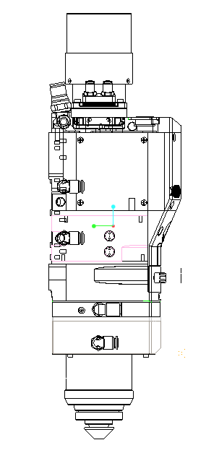
PoLeader2.0S Ultra High High Power Cutting Head Series Operating Instructions
3.2.2: air installation
The air road installation schematic diagram is shown in Figure 3.3. Air pipes of 10mm and 8mm for cooling air road. To avoid affecting the cutting quality, please note that the impurities in the cutting gas can damage the lens and cause cutting inconsistency. Table 3.2 is the recommended cutting gas specification, the higher the gas purity, the better the cutting section quality. The impurities can be filtered out in the gas supply pipeline, but oxygen and water vapor can penetrate into the optical system through non-metallic materials, which is the source of dust and hydrocarbons. Accessories of stainless steel material are recommended.
Nitrogen or nozzle cooling gas is recommended for finely filtered air with a pressure to be less than 10bar. No oxygen shall be used as a cooling gas.
Cut air path
Coololing path
Figure 3.3 Schematic diagram of PoLeader series gas road installation
Cut off the gas | Purity
Oxygen | 99.999%
Nitrogen gas | 99.99%
Table 3.2 Details of PoLeader series waterway parameters

Slide 11
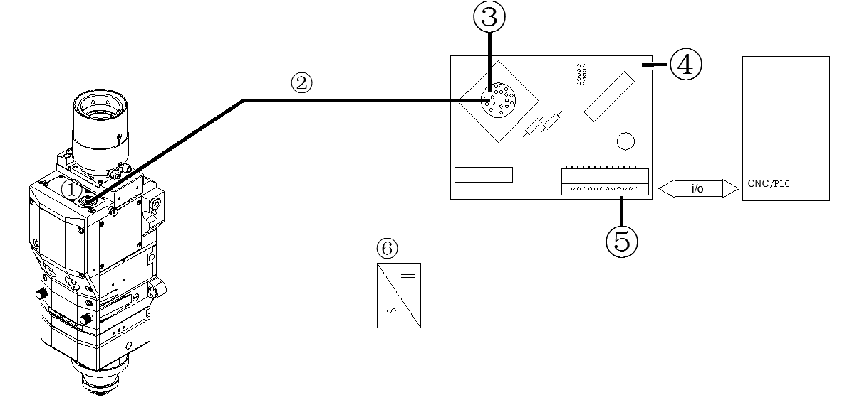
PoLeader2.0S Ultra High Power Cutting Head Series Operating Instructions
IV. System installed capacity commissioning
4.1: Cable connection and interface definition
The entire system connection is shown in Figure 4.1:
①: 19Pin aviation plug master: focus control board card
②: 15m control cable: 12 IO control ports
③: 19Pin aviation plug base: 24V power supply
After connecting the 15m control cable to the cutting aviation plug bus, the other end to the focus control card, the 24V voltage stabilizing power supply customer.
4.2: Connect of focus control board card to upper machine (IO pin definition)
The focus control card is shown in Figure 4.2.The 12 IO pin definitions are shown in Table 4.1.
Figure 4.1 Schematic diagram of the system connection

Slide 12
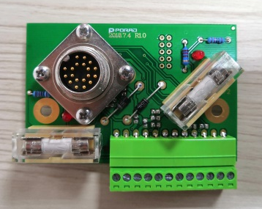
PoLeader2.0S Ultra High High Power Cutting Head Series Operating Instructions
The IO control pin definition is shown in Table 4.1:
12 IO control pins
1
12
Figure 4.2 Schematic diagram of the IO pin
Pin-bit number | Input / output | Pin definition | Comment on this one
1 | Input the signal | 24V | Power supply inside the laser head, 24V±10%,max3.5A
2 | Input the signal | 0V
3 | Input the signal | 24V | Power supply at IO port, 24V±10%,max0.5A
4 | Input the signal | 0V
5 | Input the signal | Simog selection | The standby feature is currently not open (without wiring)
6 | Output the signal | Current output | The standby feature is not currently open (without wiring)
7 | Input the signal | Re-parameter signal | Perform the focus callback function (high level valid)
8 | Input the signal | Enabling signal | Focus confirmation signal (high level valid)
9 | Output the signal | Alarm signal | Laser head internal alarm (output low level)
10 | Output the signal | Position arrival signal | Focus position has arrived (high level valid)
11 | Input the signal | Analog volume voltage + | Analog volume voltage input (0~10V)
12 | Input the signal | Analog volume and voltage-

Slide 13
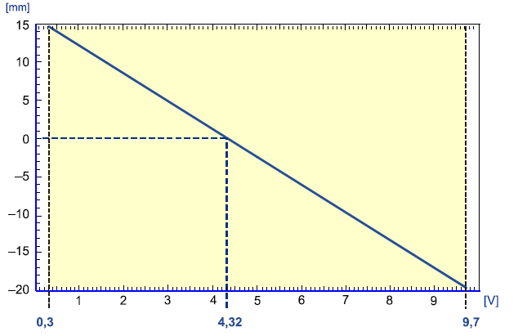
PoLeader2.0S Ultra High Power Cutting Head Series Operating Instructions
More note for these 12 IO control pins:
: The high level of the return signal is kept at at least 100ms.
: The upper position machine gives the mode corresponding to the high level of the enabling signal holding at least 50ms,
The proposed voltage remains at at least 50ms.
: The focus position is always high level and automatically when the motor moves
Low, high output level
: The upper machine must wait for the proper signal before executing the next PLC.
4.3: Setting of the focus position
4.3.1: Focus formula for F200 for 6~10KW (6~10KW)
If the laser power range of 6~10KW,F200 is the focal length of the focus mirror of 200, the maximum focus adjustment range is + 15~ -20mm, input voltage corresponding to 0~10V, as shown in FIG. 4.3.
Corresponding functional relation: analog volume voltage [V] = focus position [mm] * (–0.2685) + 4.3285

Slide 14
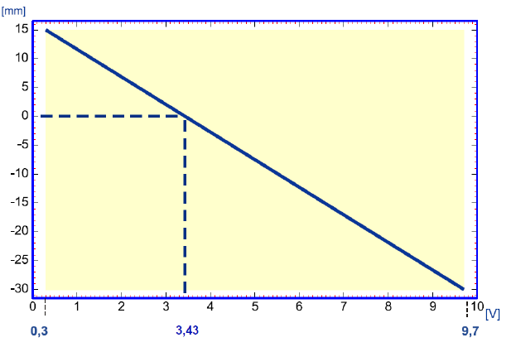
PoLeader2.0S Ultra High Power Cutting Head Series Operating Instructions
4.3.2: Focus formula for F200 of 10~30KW (10~30KW)
If the laser power range of 10~30KW,F200 is the focal length of the focus mirror of 200, the maximum range of + input voltage corresponding to 15~ to 30mm, is 0~10V, as shown in FIG. 4.4.
Corresponding functional relation: analog volume voltage [V] = focus position [mm] * (–0.2089) + 3.4333
4.3.3: Focus formula of F150
The focal distance of the focus mirror is 150, and the maximum focus adjustment range is + input voltage corresponding to 9~ -13mm, is 0~10V, as shown in FIG. 4.5:
Figure 4.4 F200 focus position and analog voltage function relation of 10 ~ 30 KW

Slide 15
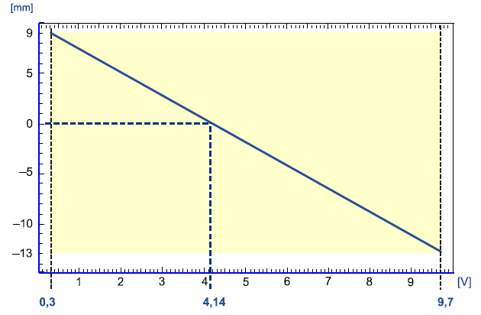
PoLeader2.0S Ultra High Power Cutting Head Series Operating Instructions
Corresponding functional relation: analog volume voltage [V] = focal position [mm] * (–0.4272) + 4.145
4.4: Status alarm information of the LED lamp
The sequence and definition of the four LED lights are shown in Figure 4.6.
Figure 4.5 Relationship between F150 focus position and analog volume voltage function

Slide 16
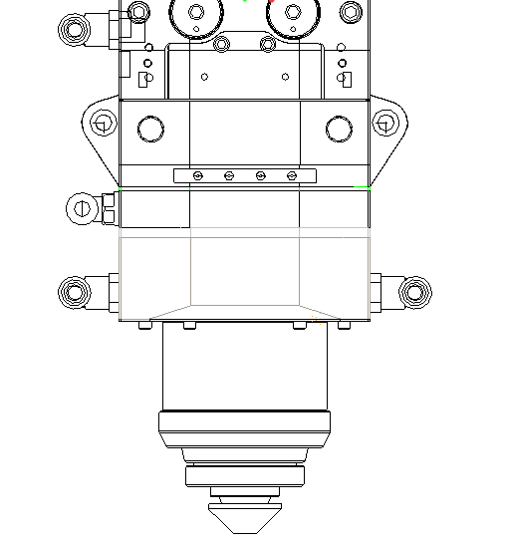
PoLeader2.0S Ultra High Power Cutting Head Series Operating Instructions
First: Lower protection mirror indicator lamp:
① Green Light: Everything is normal
② Orange to Red: The temperature of the lower protective mirror increases
The ③ red light is always on: The temperature of the lower protective mirror is> 70℃
The ④ red light flashes once in a second: No lower protection lenses
The ⑤ is not bright: No power supply
Second: Pressure indicator lamp:
① Green Light: Everything is normal
The ② red light is always on: Internal pressure of the laser head is> 1.2bar
③ red light flashes once a second: cut pressure> 25bar
The ④ is not bright: No power supply
Third: Temperature indicator lamp:
① Green Light: Everything is normal
② Orange to Red: Laser head temperature rises
The ③ red light is always on: Temperature of the laser head is> 45℃
④ red light flashes a second: temperature of collimor is> 70℃
4 LED lights
1
4
Figure 4.6 4 Location and sequence of LED lamps

Slide 17
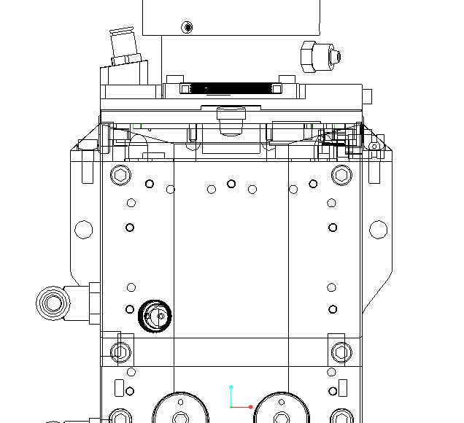
PoLeader2.0S Ultra High Power Cutting Head Series Operating Instructions
The ⑤ red light flashes three times a second: the temperature of the focus mirror is> 70℃
The ⑥ is not bright: No power supply
Fourth: Focus position indicator lamp:
① Green Light: Everything is normal
② red light: Motor failure or overload
The ③ is not bright: Motor is not in the target position
4.5: Focus position calibration
When the PoLeader series ultra-high power laser cutting head leaves the factory, due to some uncontrollable factors, the "0" focus and the "0" focus of the actual light may deviate when you receive the cutting head test, which can be calibrated by the following methods.
Step 1: Use the caliper to open the area shown in Figure 4.7 (note that wipe the tool and laser head surface with alcohol before opening)
Open this area with the caliper
Figure 4.7 Schematic diagram of the focal calibration parts

Slide 18
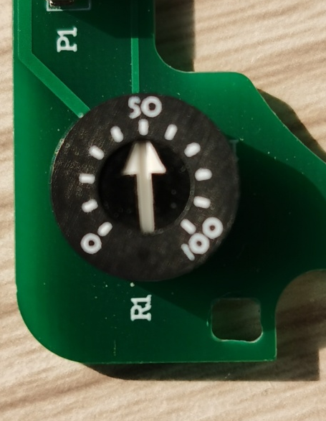
PoLeader2.0S Ultra High Power Cutting Head Series Operating Instructions
Step 2: After opening the plug, you can see the potentiometer shown in Figure 4.8 below. Extend a word screwdriver cleaned with alcohol to the hole to adjust the number of potentiometer display quickly and pay attention to the overall sealing. Please prepare a paper tape and seal the hole position after the adjustment.
Step 3: If the focus is too positive, rotate clockwise and counterclockwise if the focus is negative. Each small lattice can be adjusted after positive and negative 2mm, rotation, the focus must be returned to take effect. Close the dust with tape during the adjustment. After the adjustment, lock the plug immediately.
4.6: Baichu system platform configuration
If you are using a Berchu system, the detailed configuration parameters for the focus are shown in Figure 4.9. If you are a laser cutting head below 10KW, the focus adjustment range is + 15~ -20; if you are a laser cutting head above 10KW, the focus adjustment travel range is + 15~ -30; the focus confirmation output and the origin output port are configured according to your actual wiring, the feedback voltage and function selection is not configured, the focus confirmation delay is not less than 50ms, the return origin delay is not less than 100ms.
Figure 4.8 A potentiometer schematic diagram

Slide 19
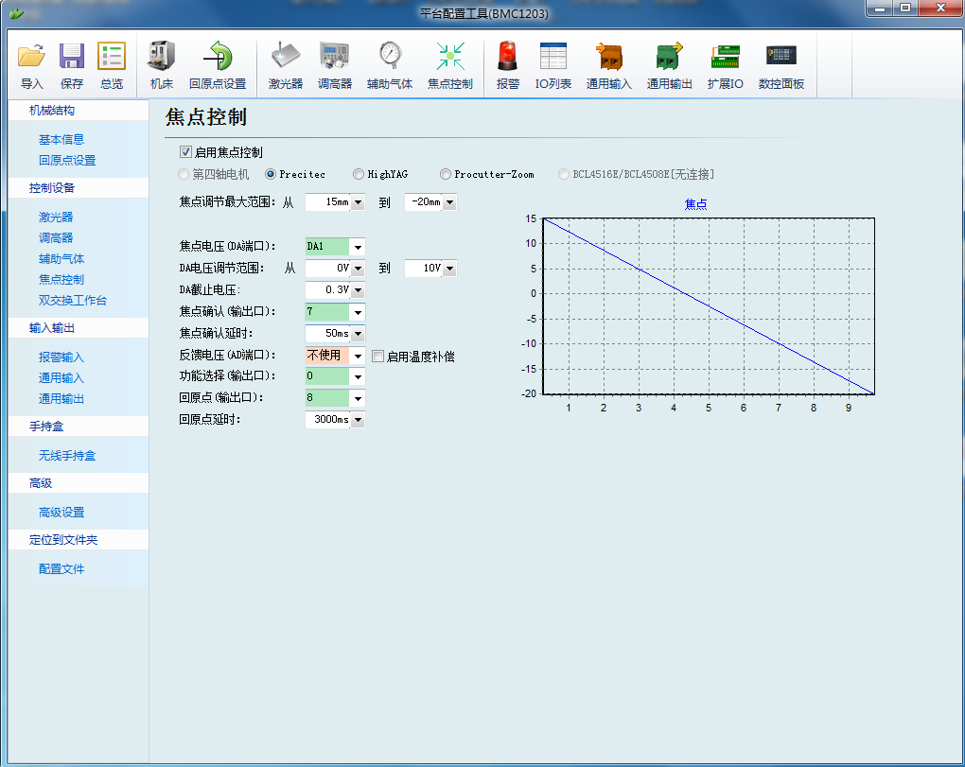
PoLeader2.0S Ultra High Power Cutting Head Series Operating Instructions
V: Product operation instructions
5.1: Beam tuning (QBH interface)
The cutting mass depends largely on whether the lens is concentric. The lens is not concentric, and the laser beam may contact the nozzle or inner wall, causing high temperature deformation. lens operation should be considered after replacing the nozzle or when the cutting quality drops. The adjustment of the PoLeader series laser cutting head can be done by adjusting the position in the X-Y direction of the focus mirror. The adjustment screw is located in the cutting head position as shown in Figure 5.1. Make sure the laser beam is output from the center of the nozzle by loosening or tightening the adjusting screw until the beam is in the middle of the nozzle. A common method of tape tapping can observe whether the laser is at the center of the slit to determine whether the lens is concentric.
Figure 4.9 Berchu configuration platform parameters

Slide 20
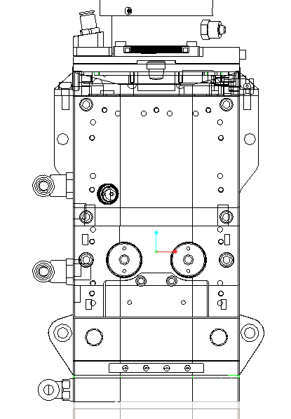

PoLeader2.0S Ultra High Power Cutting Head Series Operating Instructions
Take a transparent tape flat to stick directly below the center end of the nozzle hole, adjust the red spot to the relative center position of the nozzle; next open and adjust the laser generator at 60W-100W to manually tap; remove the tape to check that the hole is in the center of the nozzle. Repeat the above steps to find the best relative nozzle center position of the beam.
5.2: Adjust the focus position
The Type PoLeader2.0S series high-power cutting head still needs to be manually punched to redefine the focus position by changing the initial settings or replacing the lens, laser, etc.
Manual focus can refer to the following steps: 1. Set the focus position of the laser cutting head at + 15, set the laser power range to 80-100w; 2. and then open a laser within every mm (the smaller) on print paper
X-Y coaxial adjustment screws
Figure 5.1 The QBH beam adjustment center

Slide 21
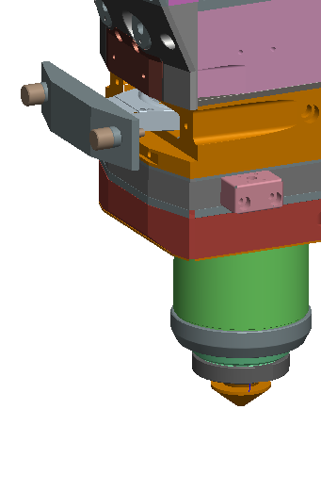
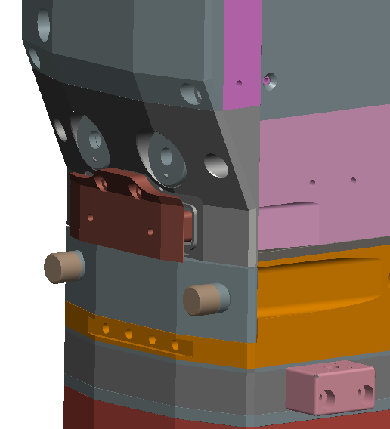
PoLeader2.0S Ultra High Power Cutting Head Series Operating Instructions
Hole; 3. Several times, the scale corresponding to the smallest hole with the aperture is zero coke, and the focus is just at the end surface of the nozzle.
If the minimum hole is not in the 00 focal point, refer to step 4.5 of this instruction.
VI: Maintenance
6.1: Clean the lens
Due to the characteristics of laser cutting, regular lens maintenance, it is recommended to be cleaned once a week. For facilitate maintenance of the mirror, the mirror holder has a drawer structure, as shown in Figure 6.1.
6.1.1: replace the lower protection mirror
The lower protective mirror is vulnerable, which shall be replaced after damage. As shown in Figure 6.2, unscrew the two locking screws, pull out the protective mirror seat, remove the protective mirror pressure ring, wear the finger sleeve and remove the lens; clean the lens, mirror seat and sealing ring,
Lower protective mirror drawer
Focus on the protection mirror drawer
Figure 6.1 Protective mirror drawer structure

Slide 22
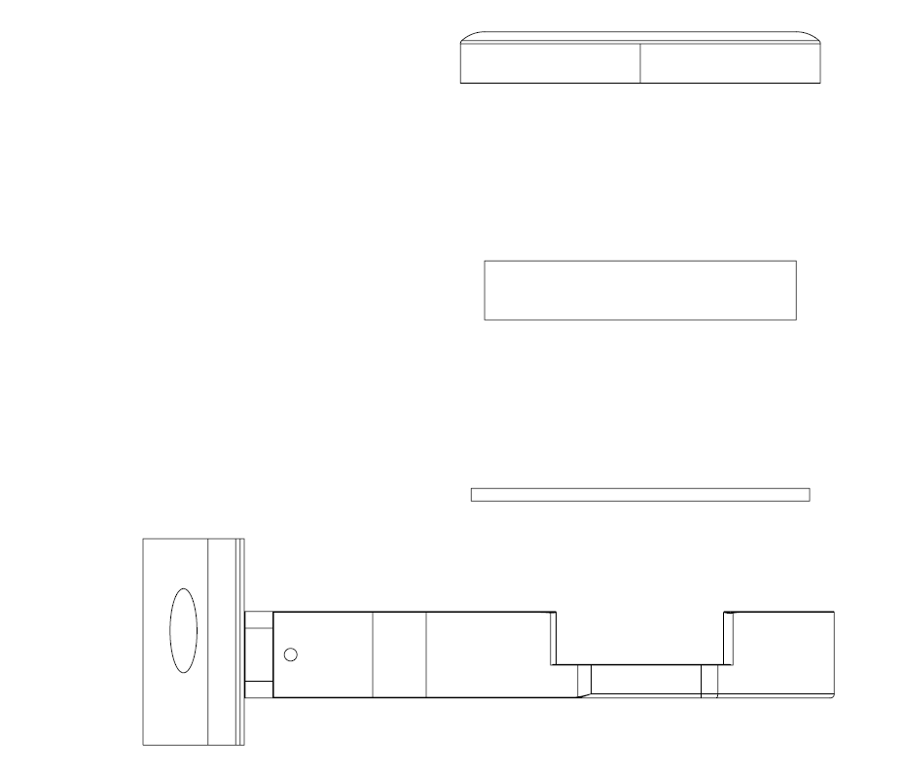
PoLeader2.0S Ultra High Power Cutting Head Series Operating Instructions
If the spring seal ring is damaged, replace a new one, install the wipe clean lens (regardless front and reverse) into the drawer seat, install the protective mirror ring, plug the protection seat back to the laser processing head, and tighten the lock screws.
6.1.2: Focus Protection Replacement
The focus protection mirror will also be damaged for a long time. As shown in Figure 6.3, unscrew the two locking screws, take out the focus protection drawer, wear the finger plug cover; clean the lens, mirror seat and sealing ring. If the plug is damaged for a new one, install the new clean lens (both front and negative) into the drawer holder, install the focus protection drawer, plug the protection mirror back to the laser processing head, and tighten the locking screws.
Lower protection mirror pressure ring
Lower protection lens
Spring sealing ring
Lower mirror base
Figure 6.2 Protection mirror drawer structure

Slide 23
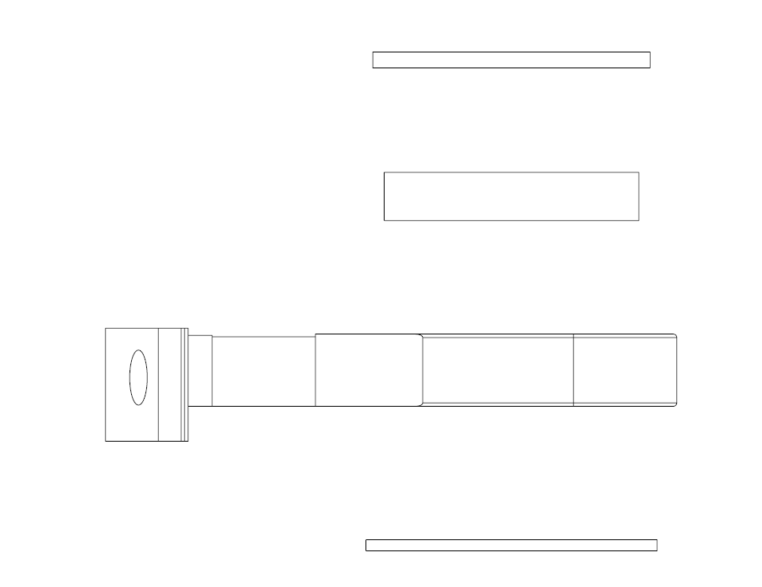
PoLeader2.0S Ultra High Power Cutting Head Series Operating Instructions
6.2: Replace the spray nozzle and the ceramic body
During normal cutting operation, the laser head hits, so it is necessary to check whether the cut mouth and the ceramic body are damaged. The nozzle and ceramic body structure are as shown in Figure 6.3.
1: Replace the ceramic body
• undown the nozzle;
• hand press the ceramic body to make it fixed not inclined, and then spin down the sleeve;
• aligned the pin holes of the new ceramic with two positioning pins and presses the pottery by hand
Porcelain body, spin on the pressure sleeve;
• spin the nozzle and tighten with appropriate strength.
Pan plug seal
Focus on the protection lens
Focus on the protection drawer base
Lubrication sheet
Figure 6.3 Focus protection mirror drawer structure

Slide 24
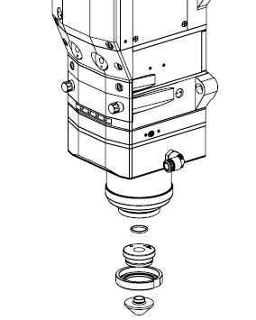
PoLeader2.0S Ultra High Power Cutting Head Series Operating Instructions
2: Replace the cut mouth
• Unscrew the nozzle;
• replace the new nozzle and retighten with appropriate strength.
• Capitance calibration must be repeated after replacing the nozzle or ceramic.
Seal ring
Ceramic body
Lock the nuts
Cut off the mouth
Figure 6.3 Nozzles and ceramic structure

Slide 25

PoLeader2.0S Ultra High Power Cutting Head Series Operating Instructions
Thank you for purchasing our company products
Polonium radiadium technology
Global attention
Suzhou Polonium Radium Automation Technology Co., Ltd
Suzhou Porad Automation Technology Co.,Ltd
Tel: 0512-36694173
Fax: 0512-50173236
Address: Room 418, Yuda Science Park, No.6, Leshan Road, Leshan Town, Kunshan City, Jiangsu Province
Email: www.szporad.com
Website: www.szporad.com

